Slide 1
PHP MySQL Database
Murali

Slide 2
What is Database?
A database is a separate application that stores a collection of data.
A Relational DataBase Management System (RDBMS) is a software that:
Enables you to implement a database with tables, columns, and indexes.
Guarantees the Referential Integrity between rows of various tables.
Updates the indexes automatically.
Interprets an SQL query and combines information from various tables.

Slide 3
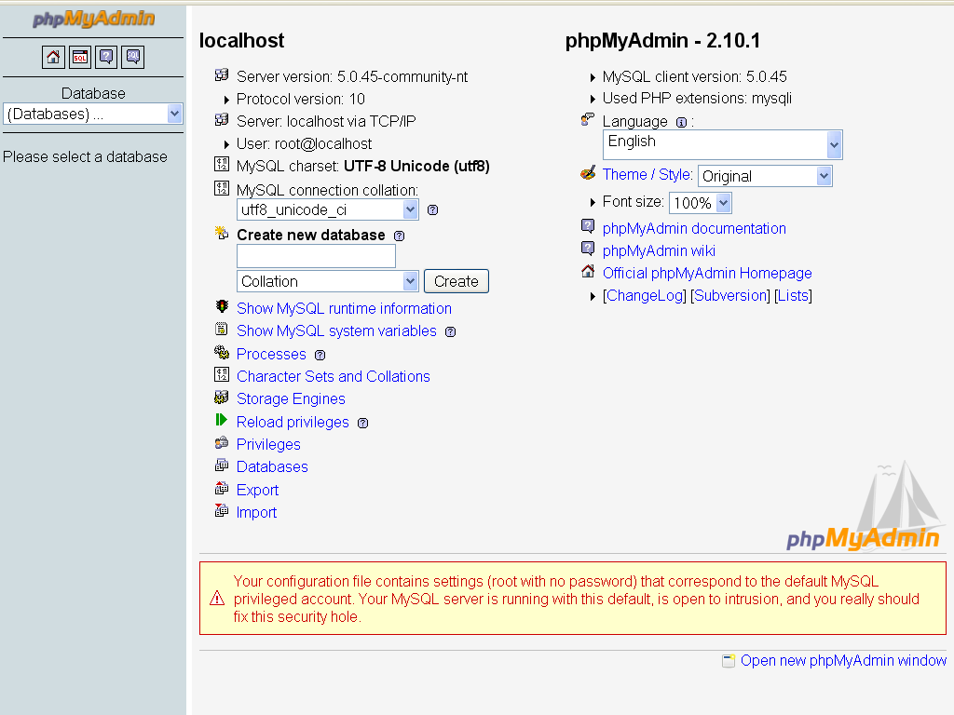
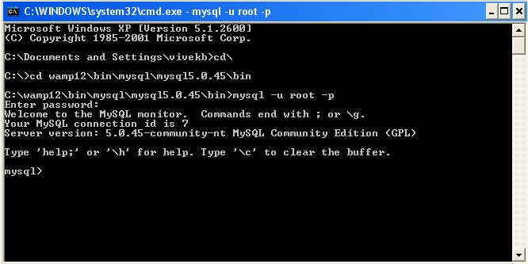
MySQL Installation
Windows –
WampSerever2.0 PhpMyAdmin
Command line access

Slide 4
MySQL Database Connection
PHP provides mysqli_connect function to open a database connection.
Syntax:connection mysqli_connect(server,user,passwd);
Parameter | Description
server | Optional - The host name running database server. If not specified then default value is localhost:3036.
User | Optional - The username accessing the database. If not specified then default is the name of the user that owns the server process.
Passwd | Optional - The password of the user accessing the database. If not specified then default is an empty password.

Slide 5
<?php
$servername = "localhost";
$username = "username";
$password = "password";
// Create connection
$conn = mysqli_connect($servername, $username, $password);
// Check connection
if (!$conn) {
die("Connection failed: " . mysqli_connect_error());
}
echo "Connected successfully";
mysqli_close($conn);
?>

Slide 6
Example
<?php
$servername = "localhost";
$username = "username";
$password = "password";
// Create connection
$conn = new mysqli($servername, $username, $password);
// Check connection
if ($conn->connect_error) {
die("Connection failed: " . $conn->connect_error);
}
echo "Connected successfully";
$conn->close();
?>

Slide 7
Create MySQL Database Using PHP
To create and delete a database you should have admin priviledge. Its very easy to create a new MySQL database. PHP uses mysql_query function to create a MySQL database. This function takes two parameters and returns TRUE on success or FALSE on failure.
Syntax: mysql_query( sql, connection );
Parameter | Description
sql | Required - SQL query to create a database
Connection | Optional - if not specified then last opend connection by mysql_connect will be used.

Slide 8
Object Oriented
      <?php
      $servername = "localhost";
      $username = "username";
      $password = "password";
      // Create connection
      $conn = new mysqli($servername, $username, $password);
      // Check connection
      if ($conn->connect_error) {
      die("Connection failed: " . $conn->connect_error);
      }
      // Create database
      $sql = "CREATE DATABASE myDB";
      if ($conn->query($sql) === TRUE) {
      echo "Database created successfully";
      } else {
      echo "Error creating database: " . $conn->error;
      }
      $conn->close();
      ?>

Slide 9
Procedual
<?php
$servername = "localhost";
$username = "username";
$password = "password";
// Create connection
$conn = mysqli_connect($servername, $username, $password);
// Check connection
if (!$conn) {
die("Connection failed: " . mysqli_connect_error());
}
// Create database
$sql = "CREATE DATABASE myDB";
if (mysqli_query($conn, $sql)) {
echo "Database created successfully";
} else {
echo "Error creating database: " . mysqli_error($conn);
}
mysqli_close($conn);
?>

Slide 10
Creating Database Tables :
    <?php
    $dbhost = 'localhost';
    $dbuser = 'root';
    $dbpass = 'rootpassword';
    $dbname='test'
    // Create connection
    $conn = new mysqli($servername, $username, $password, $dbname);
    // Check connection
    if ($conn->connect_error) {
    die("Connection failed: " . $conn->connect_error);
    }$sql = 'CREATE TABLE employee( '.
    'emp_id INT NOT NULL AUTO_INCREMENT, '.
    'emp_name VARCHAR(20) NOT NULL, '.
    'join_date timestamp(14) NOT NULL, '.
    'primary key ( emp_id ))';
    if ($conn->query($sql) === TRUE) {
    echo "Table MyGuests created successfully";
    } else {
    echo "Error creating table: " . $conn->error;
    }$conn->close();
    ?>

Slide 11
      <?php
      $servername = "localhost";
      $username = "username";
      $password = "password";
      $dbname = "myDB";
      // Create connection
      $conn = new mysqli($servername, $username, $password, $dbname);
      // Check connection
      if ($conn->connect_error) {
      die("Connection failed: " . $conn->connect_error);
      }
      $sql = "INSERT INTO MyGuests (firstname, lastname, email)
      VALUES ('John', 'Doe', 'john@example.com')";
      if ($conn->query($sql) === TRUE) {
      $last_id = $conn->insert_id;
      echo "New record created successfully. Last inserted ID is: " . $last_id;
      } else {
      echo "Error: " . $sql . "<br>" . $conn->error;
      }
      $conn->close();
      ?>

Slide 12
<?php
$servername = "localhost";
$username = "username";
$password = "password";
$dbname = "myDB";
// Create connection
$conn = new mysqli($servername, $username, $password, $dbname);
// Check connection
if ($conn->connect_error) {
die("Connection failed: " . $conn->connect_error);
}
$sql = "INSERT INTO MyGuests (firstname, lastname, email)
VALUES ('John', 'Doe', 'john@example.com');";
$sql .= "INSERT INTO MyGuests (firstname, lastname, email)
VALUES ('Mary', 'Moe', 'mary@example.com');";
$sql .= "INSERT INTO MyGuests (firstname, lastname, email)
VALUES ('Julie', 'Dooley', 'julie@example.com')";
if ($conn->multi_query($sql) === TRUE) {
echo "New records created successfully";
} else {
echo "Error: " . $sql . "<br>" . $conn->error;
}
$conn->close();
?>

